Slide 1
Basis of Homeostasis

Slide 2



Slide 3

Homeostasis
When you go out on a winter day, you might shiver from the cool air, and find your skin becomes cold to the touch.
However, if you took a thermometer and measured your internal body temperature, you would find it has stayed a toasty 37∘C. Your body has stayed warm, despite the cold!
This is thanks to a process called homeostasis, which is the focus of this lesson.

Slide 4
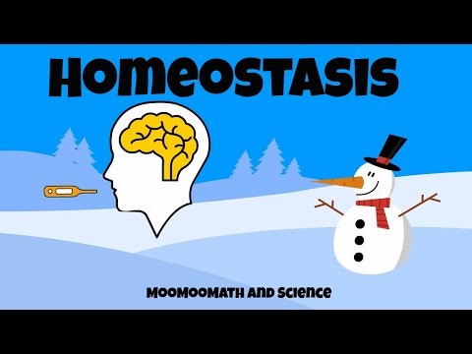

Slide 5

What is homeostasis?
Well, we can learn a lot about it by looking at the Greek words it is derived from. Homeo means similar, and stasis means stable. So, homeostasis is about keeping things similar or stable.
In other words, it is all about preventing or fighting against change!

Slide 6

The internal environment
In biology, a living organism keeps their internal environment stable through homeostasis.
But wait, what do we mean by internal environment?

Slide 7
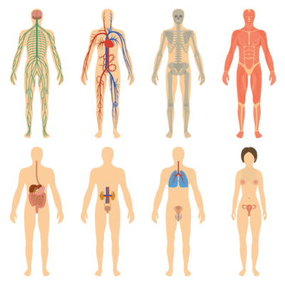
The internal environment is anything having to do with the inside of the body!
Important factors that shape the internal environment include body temperature, ion concentrations, water content, and blood glucose levels (the concentration of sugar in the blood).
Through homeostasis, the body works to keep these factors the same, so that the internal environment does not change.

Slide 8
Ok, so homeostasis is how our body stops its internal environment from changing.
But why would our internal environment change?

Slide 9

We are constantly being influenced by our external environment.
The external environment is everything around you, such as the temperature of the room, the humidity of the air and the availability of resources, like water and food.
The external environment is constantly changing, and these changes can affect our bodies.

Slide 10

Homeostasis is what helps us to maintain our internal body temperature!
For instance, a hot day can threaten to heat you up, while a cold day tries to cool you down. If you did not have homeostasis, your body temperature would fluctuate all over the place as the weather changed!
Instead, your body works to keep its internal temperature the same, even when it is hot or cold out.

Slide 11
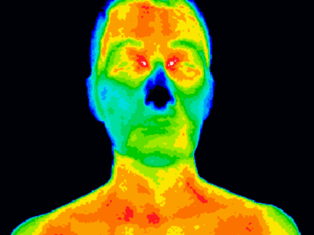
So, what does the body actually do to maintain homeostasis?
Well, there are lots of things the body can do, and it will use different methods depending on how its internal environment is being changed.

Slide 12
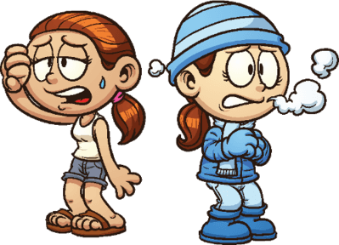
For example, when you are too hot, the body sweats.
As the sweat evaporates, it takes heat from your body and cools you down. Similarly, when you are cold, you shiver. This shivering produces heat that warms you up.

Slide 13

The body fights to keep its internal environment the same, even when the external environment is acting to change it.
This process is called homeostasis.

Slide 14
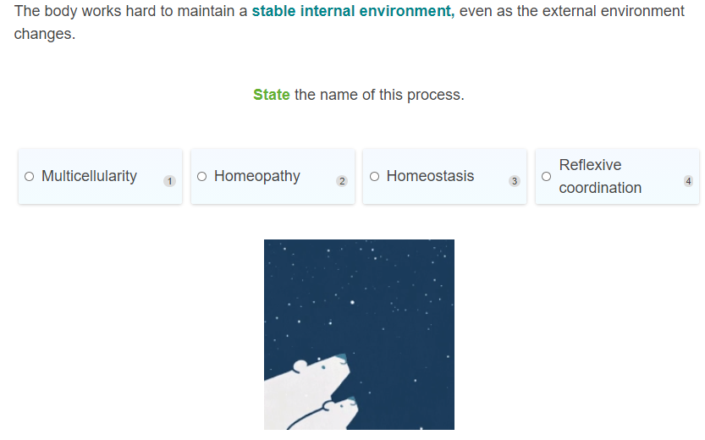

Slide 15
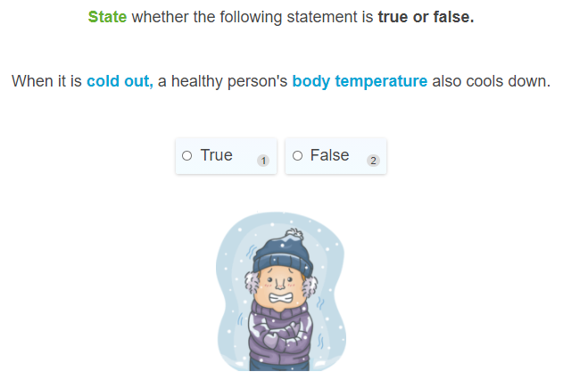

Slide 16
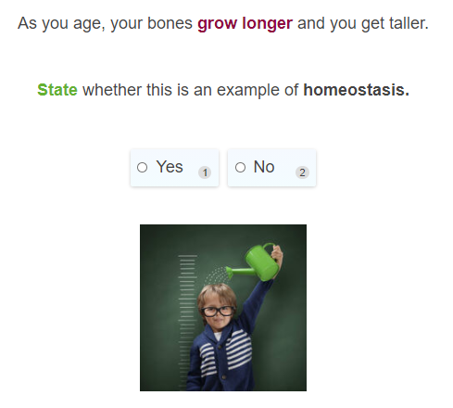

Slide 17
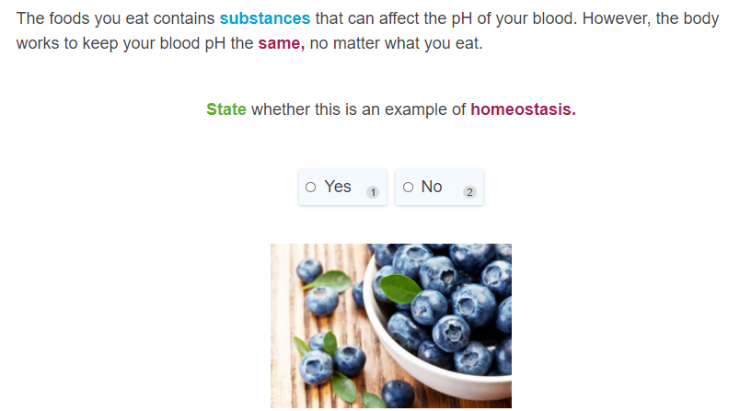

Slide 18
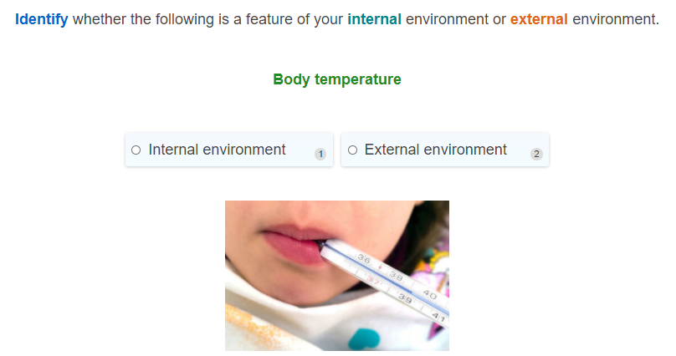

Slide 19
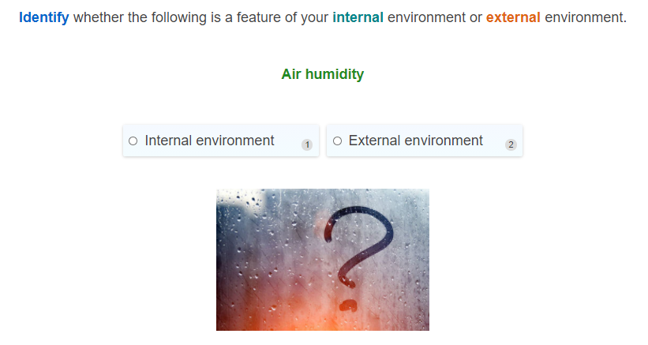

Slide 20
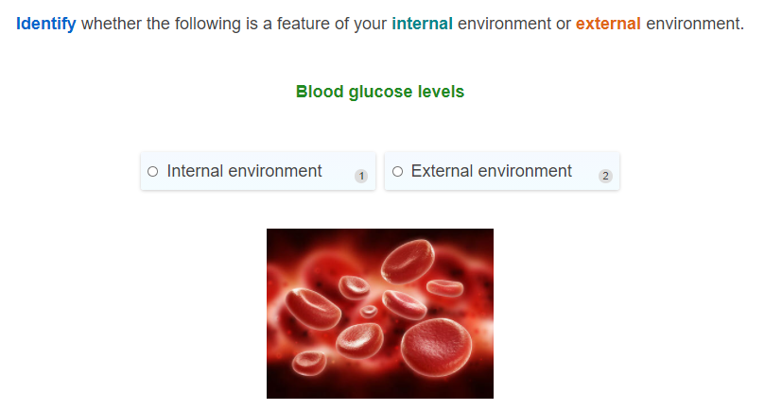

Slide 21

Why does homeostasis matter?
We get that the body maintains a stable internal environment. But why does it do this? Why not just let the internal environment change with the external environment?

Slide 22

Homeostasis is very important for our health.
This is because our bodies work best under certain conditions. Our body temperature, blood pressure, water concentration and other factors need to be within certain ranges for us to function properly. If they fall outside these ranges, we can get very sick, or even die!

Slide 23

Maintaining a constant internal body temperature is very important
Let's look at temperature. A healthy body temperature for a human is between 36.5∘C and 37.5∘C. Any lower or higher and we can start having problems.
This is why people can die by falling into cold water. The water is too cold for the body to be able to maintain a stable internal temperature, and the person's body temperature starts to drop. This gives them a condition called hypothermia, which makes them very sick or kill them.

Slide 24
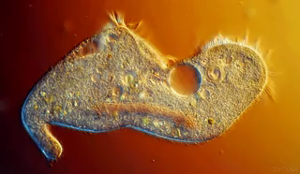
Is homeostasis only important for humans? The answer is no!
Homeostasis is important for all living organisms. This includes animals, plants, fungi and even bacteria! All living organisms need to control their internal environment in order to stay healthy.

Slide 25

Homeostasis is important because it keeps us healthy.
This isn’t just important for us; it is important for all living organisms!

Slide 26


Slide 27
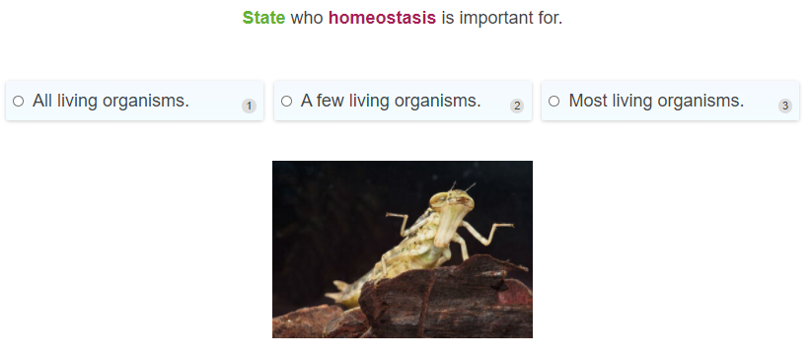

Slide 28
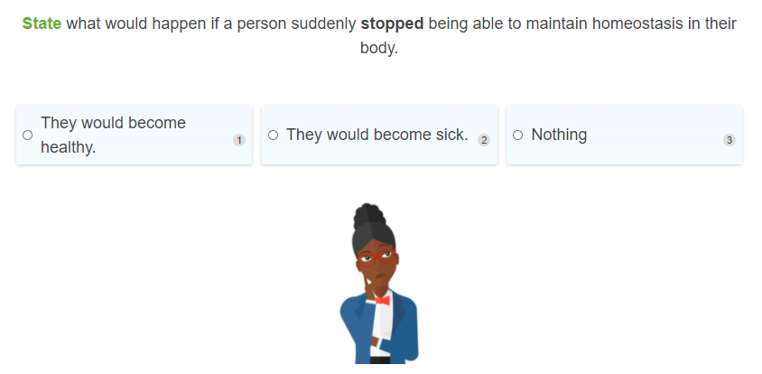

Slide 29


Slide 30
